Slide 1
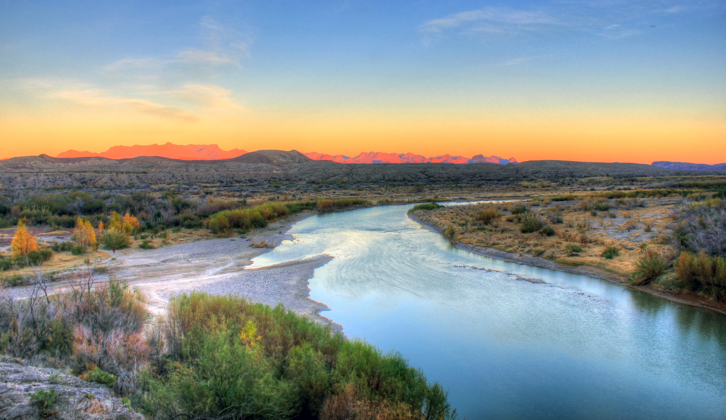

Get Outside Alliance
Web app dashboard
Project Management
Team 2
Sami Eldaw
Charaf Lachouri
Kevin Maldonado
Tatiana Uklist
Tanner Waggoneer
5/10/2023

Slide 2
Project Origin and Motivation
The project team’s mission is to develop a resource for the Get Outside Alliance team to scale their outreach and eventually scale their volunteer participation so that the team can focus their efforts on creating more volunteer opportunities with the Texas State Park System

Slide 3
Effective tools help an organization scale
Creating a tool that can scale with the Get Outside Alliance
The tool helps make the Get Outside Alliance team more efficient by allowing them to do volunteer research in one place
Having this tool in place creates an easy and non-technical experience for the Get Outside Alliance team

Slide 4
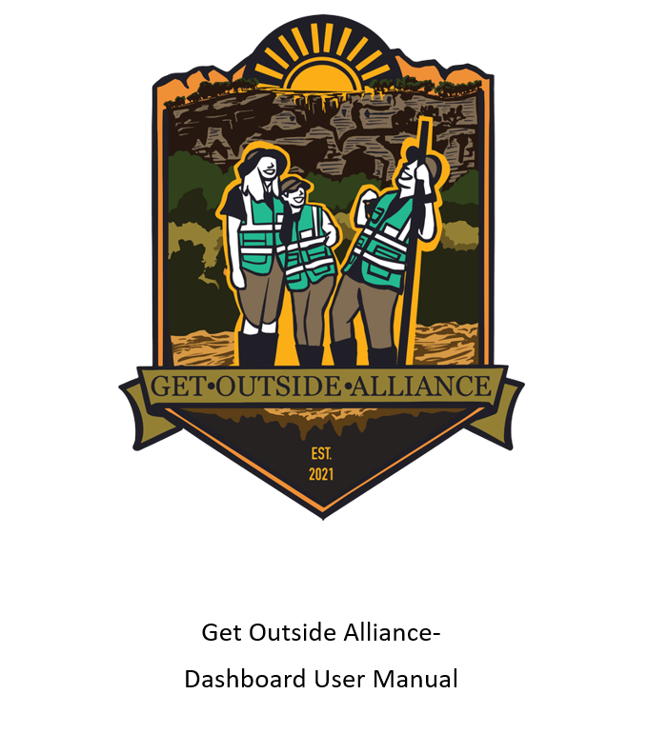
Objectives
Create a dashboard or tool that shows demographic data for counties containing State Parks
Create a user manual for the dashboard/tool created

Slide 5
Mission Statement
The project team’s mission is to develop a resource for the Get Outside Alliance team to scale their outreach and eventually scale their volunteer participation so that the team can focus their efforts on creating more volunteer opportunities with the Texas State Park System

Slide 6
Dashboard Design (for any dashboard type questions, I’d put the screenshots of the environment when it’s running)

Slide 7

User Manual
9% silver
18% silver
5% cross
9% cross
86% red
73% red

Slide 8
Key Takeaways ​
Working in a sprint mindset versus an overall deadline mindset helped our team work more effectively
Having an easy and communicative client helped with the overall implementation
Sometimes change and shifting the project focus is necessary
Questions?

